Slide 1
Dashboard Harmonization Product Suite

Slide 2
DataCube

Slide 3
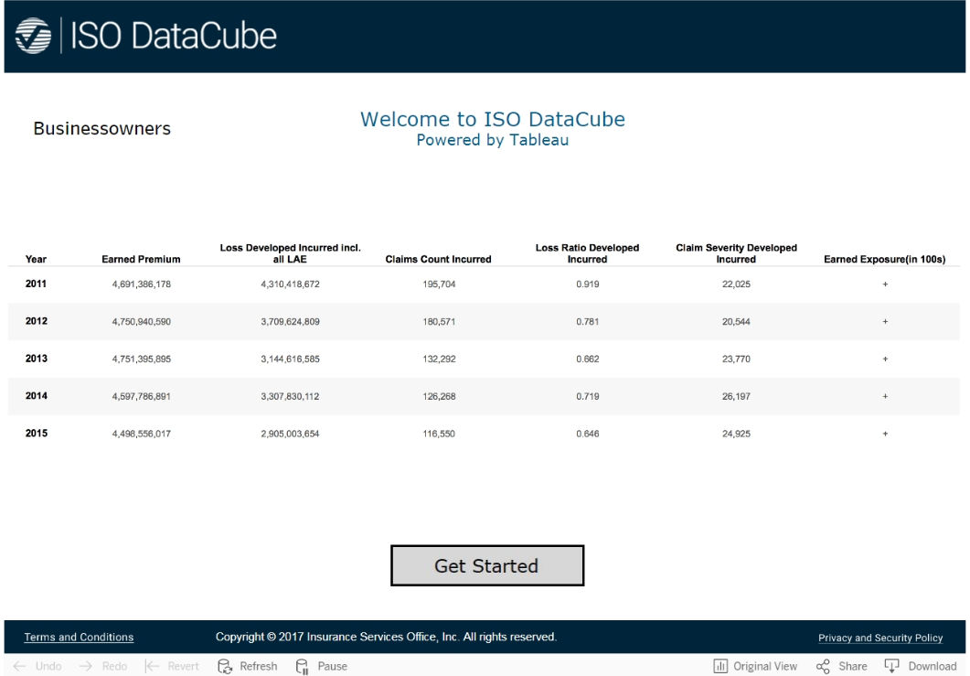
DataCube Landing Page

Slide 4
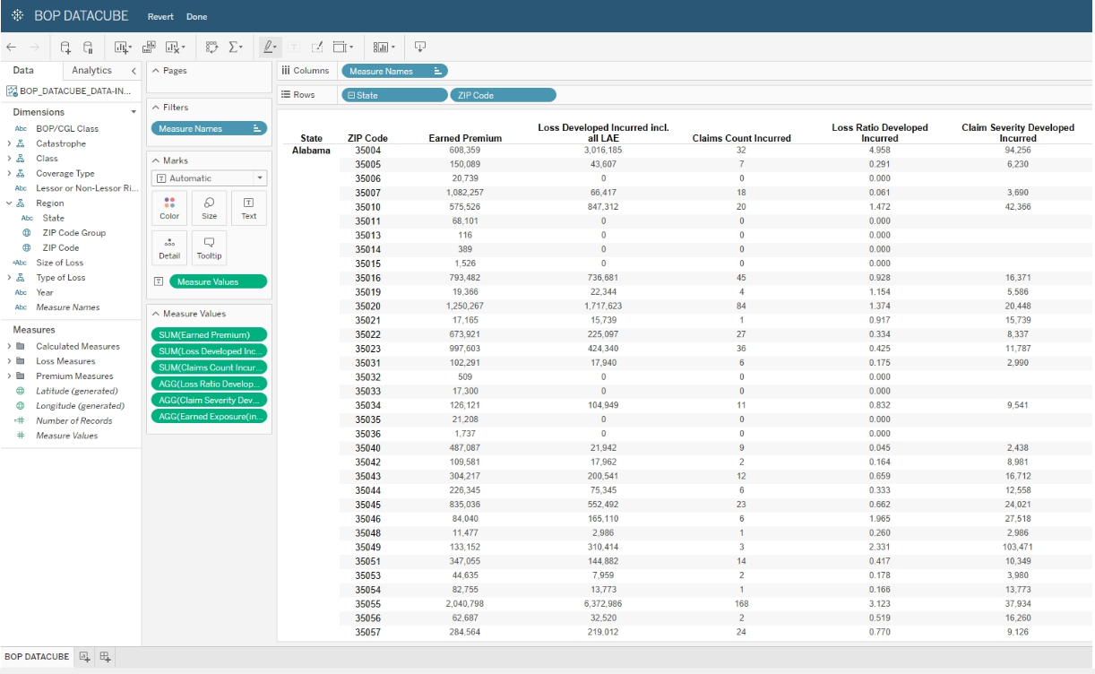
DataCube - State Zip code

Slide 5
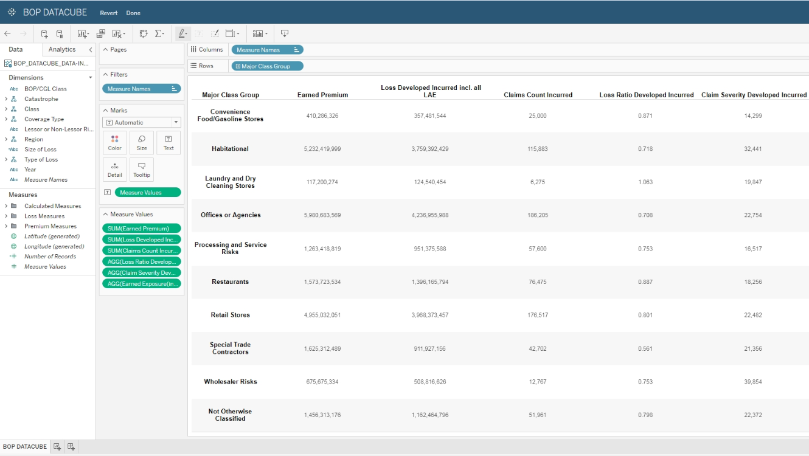
DataCube - Major Class

Slide 6
Market Landscape

Slide 7
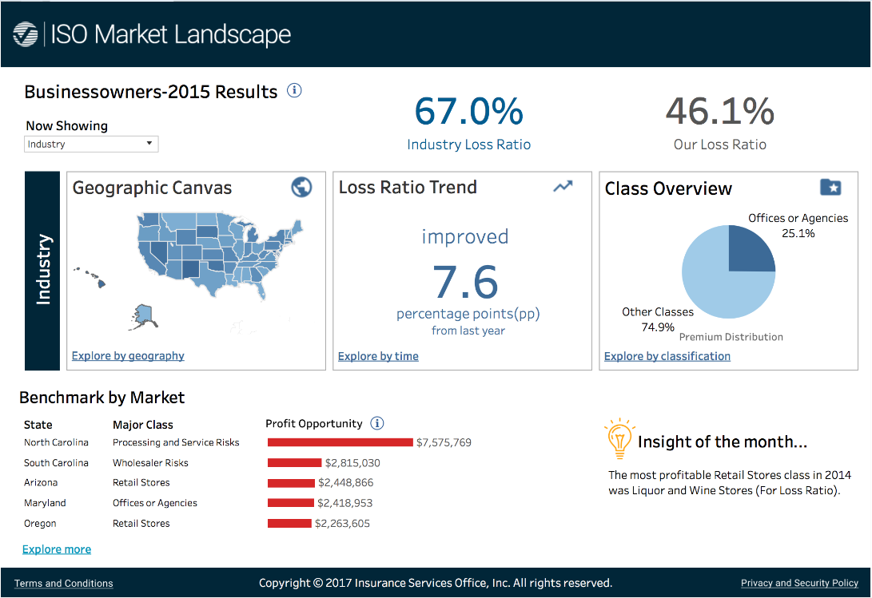
Market Landscape – Landing Page

Slide 8
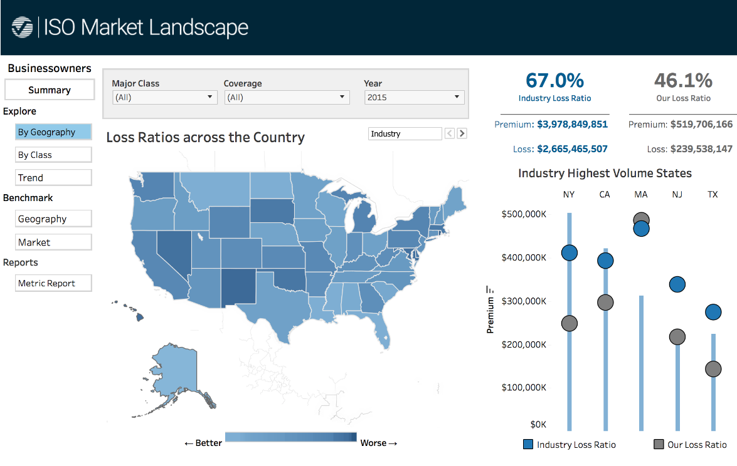
Market Landscape – Explore by State, County, Zip

Slide 9
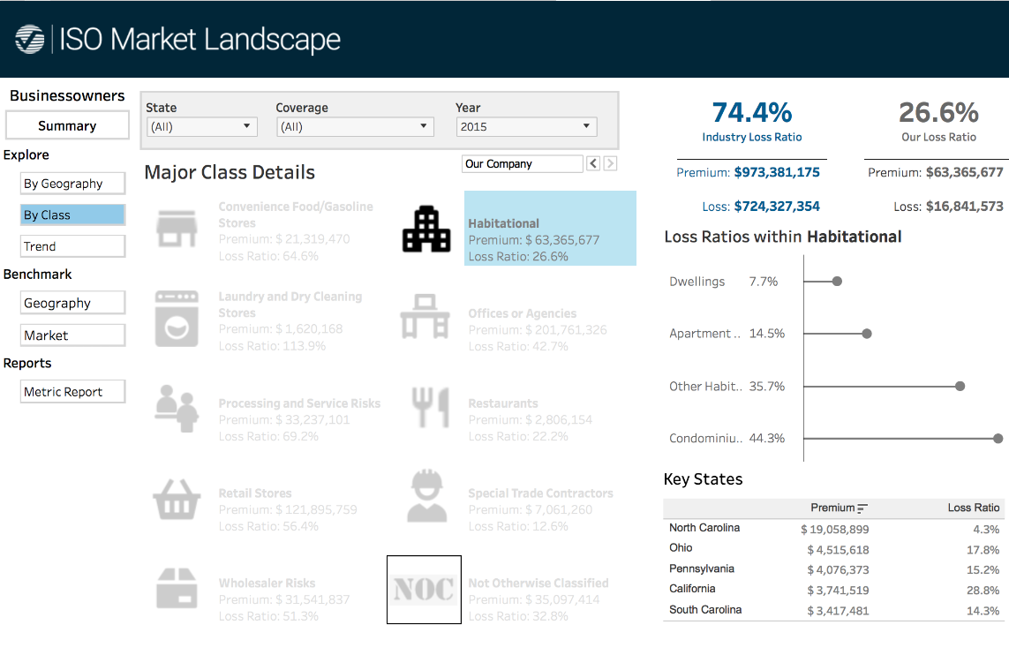
Market Landscape – Major Class, Sub-class, Class

Slide 10
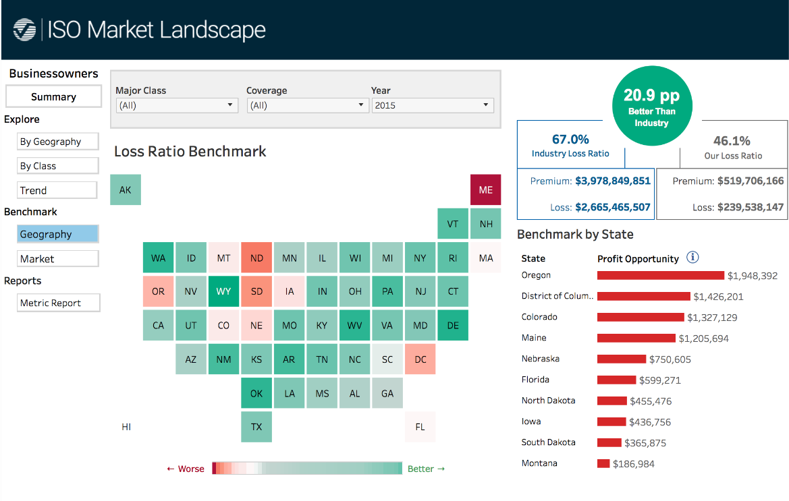
Market Landscape – Benchmarking by State/County

Slide 11
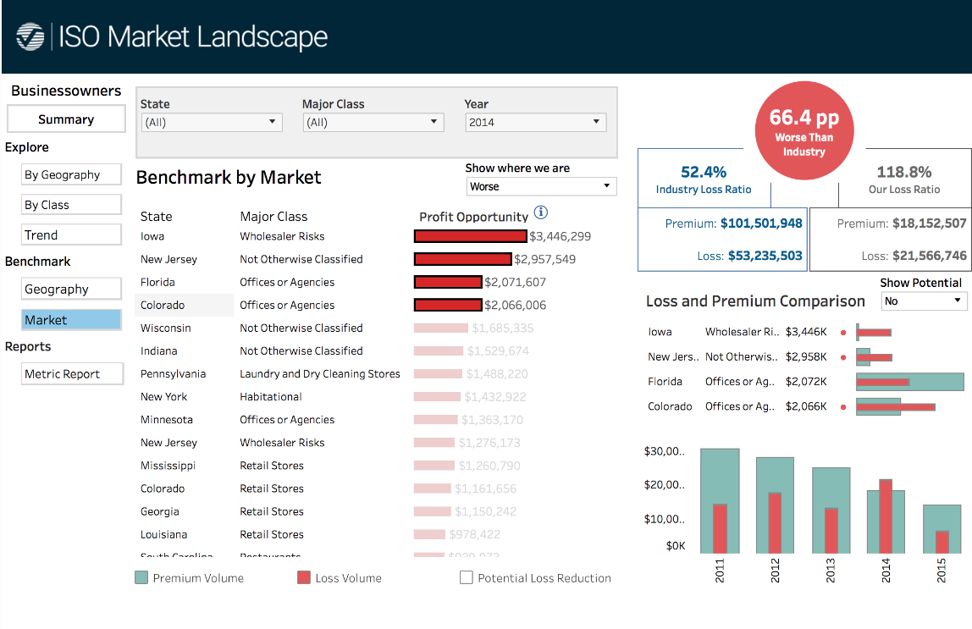
Market Landscape – Benchmarking by Market

Slide 12
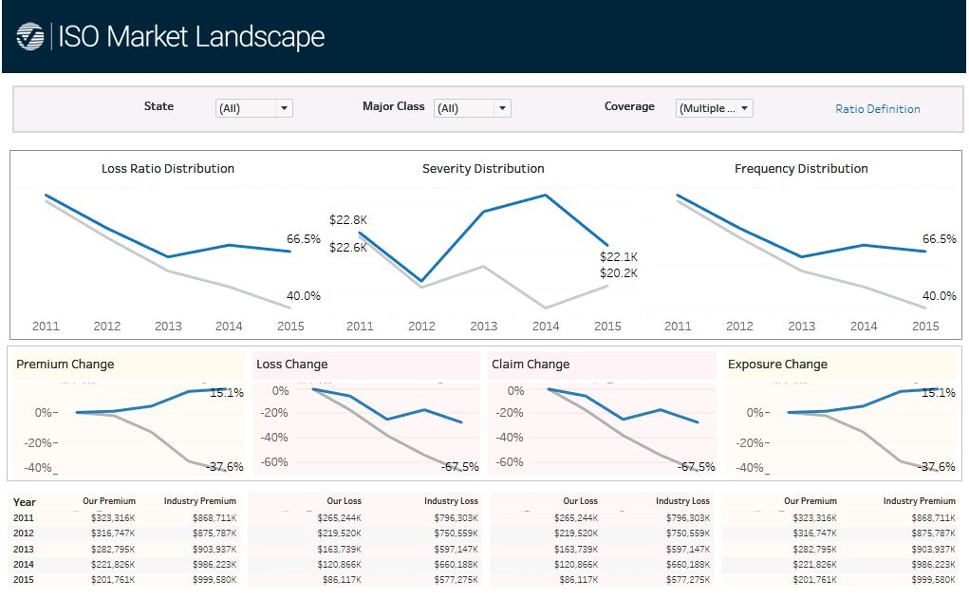
Market Landscape – Trend Benchmarking

Slide 13
MarketStance

Slide 14
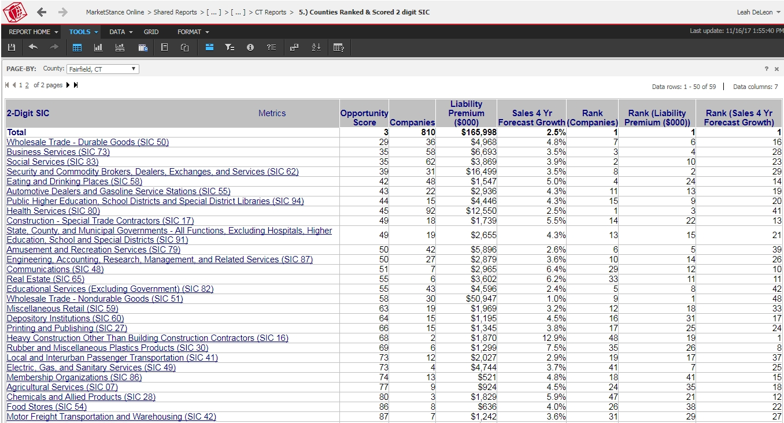
MarketStance – Commercial Insight

Slide 15
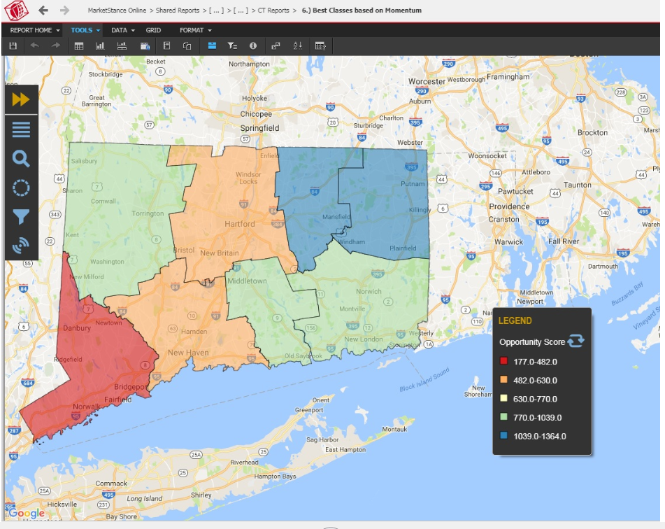
MarketStance - Commercial Insight

Slide 16
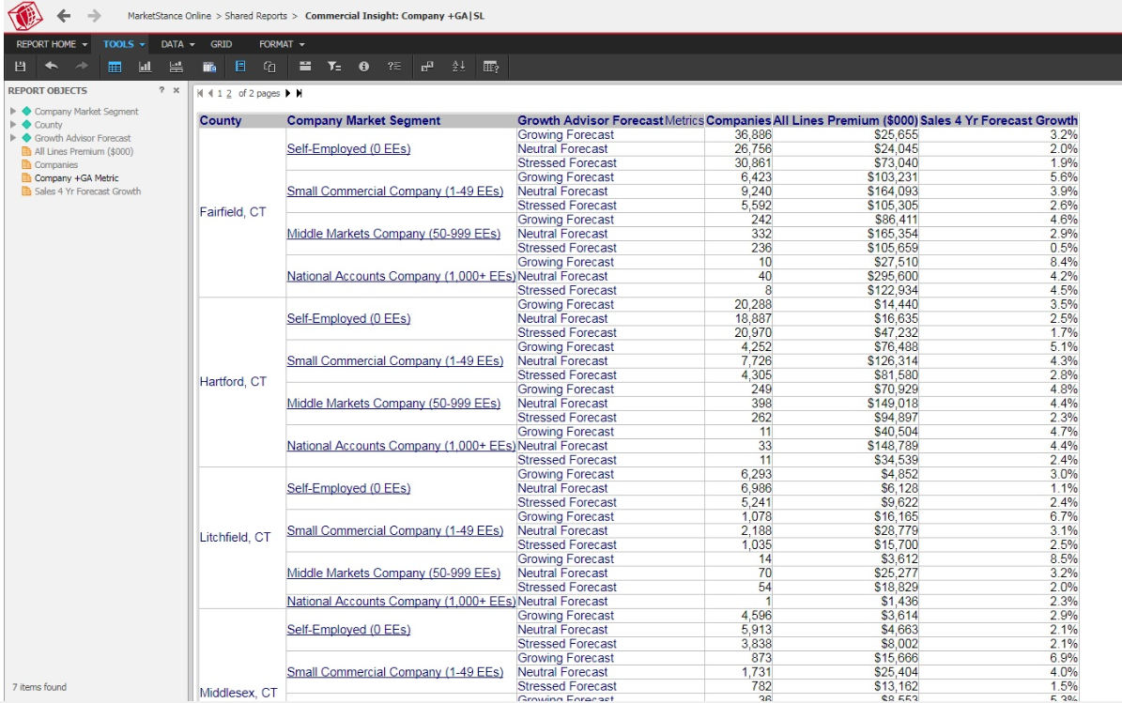
MarketStance - Commercial Insight

Slide 17
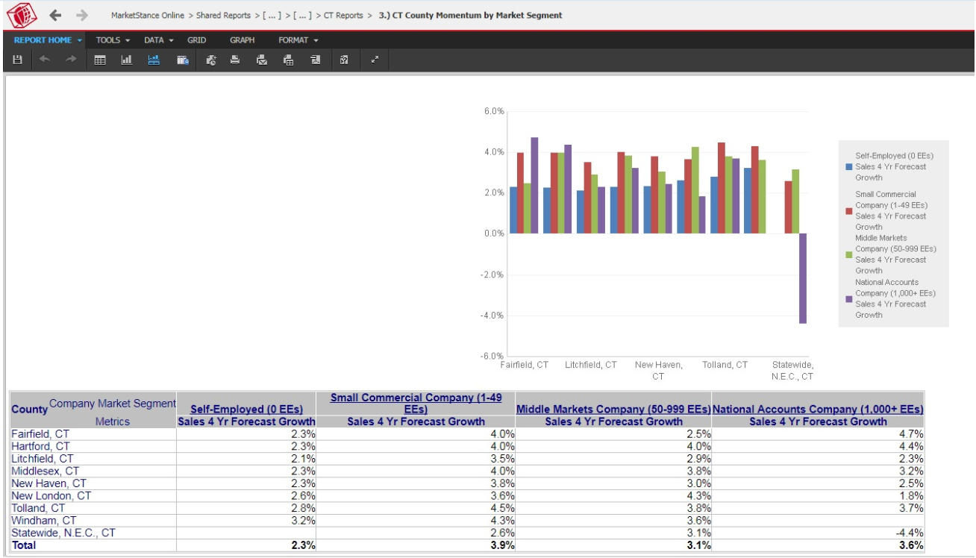
MarketStance – Commercial Insight

Slide 18
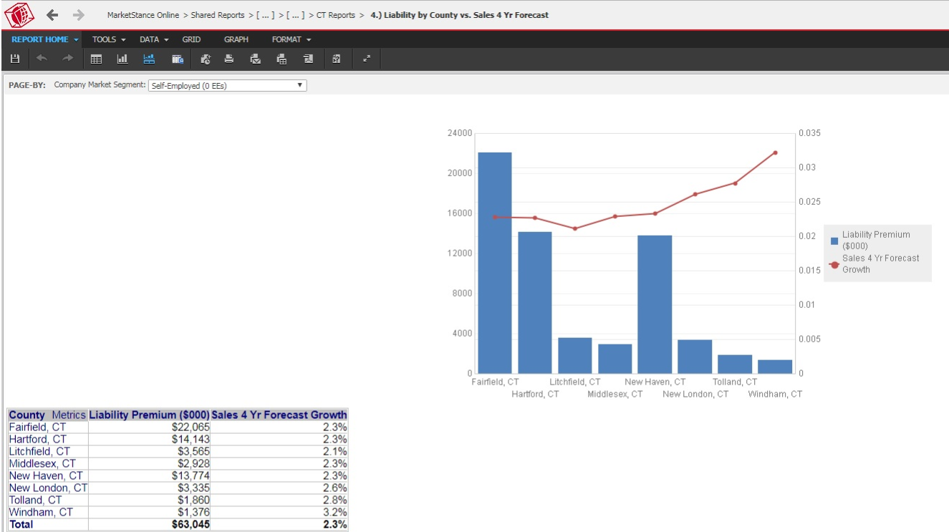
MarketStance – Commercial Insight

Slide 19
MarketWatch

Slide 20
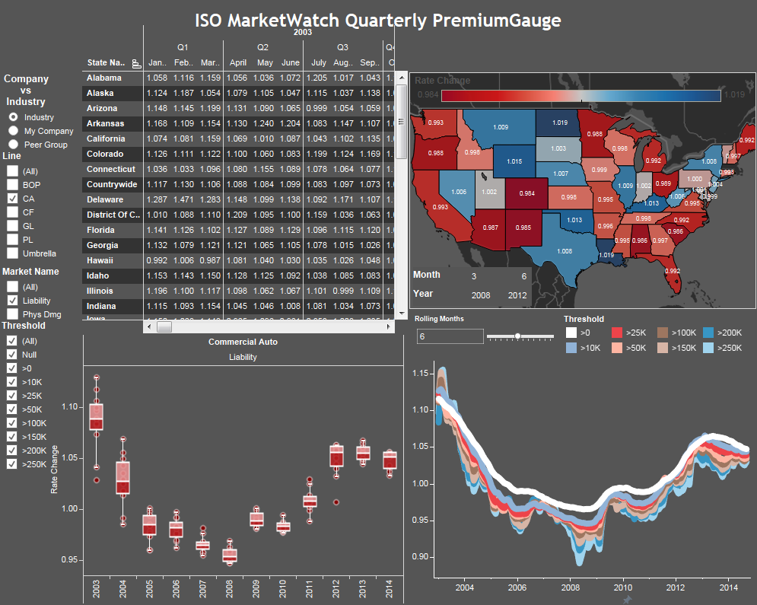
MarketWatch Dashboard – Prototype 2018

Slide 21
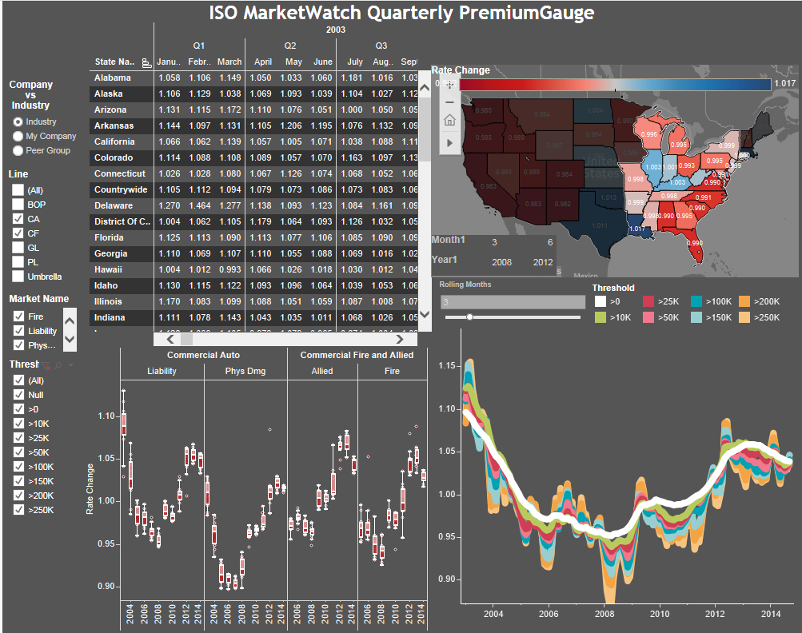
MarketWatch Dashboard – Prototype 2018 (Region / rolling month drill down)

Slide 22
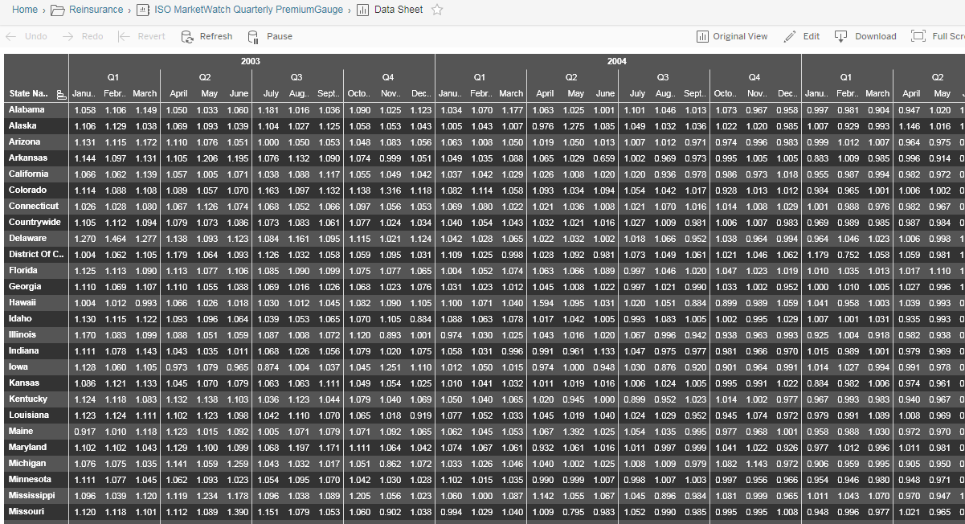
MarketWatch Dashboard – Prototype 2018 – Sample Underlying Data

Slide 23
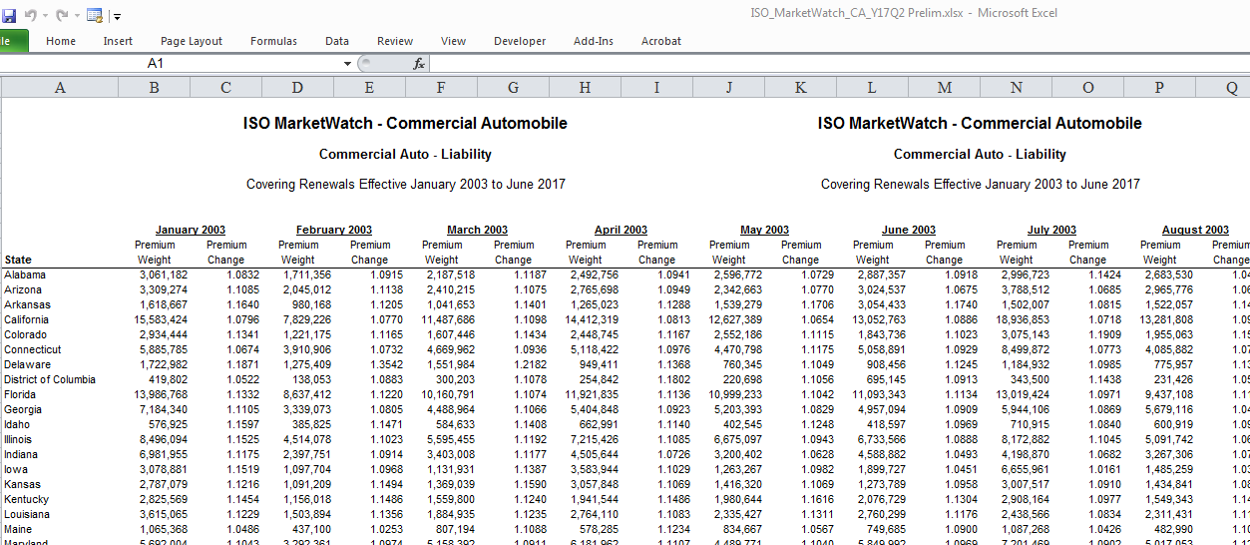
MarketWatch – Rate Change Data in Excel

Slide 24
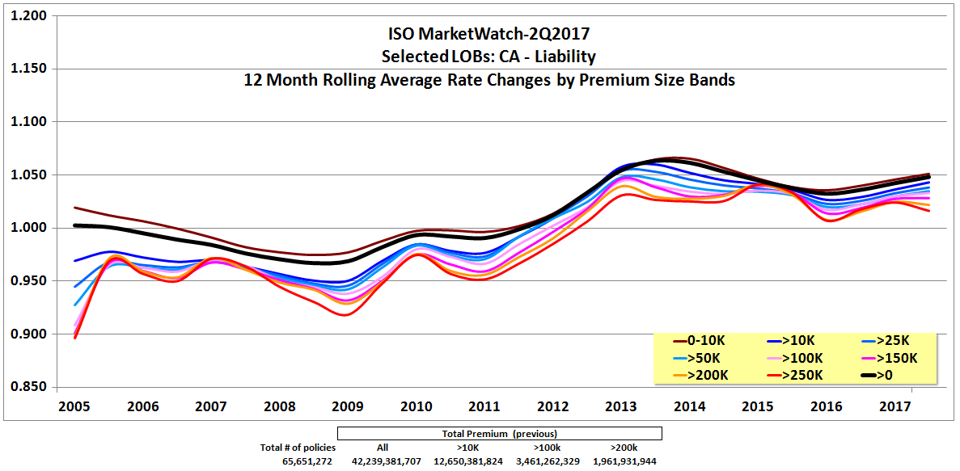
MarketWatch – Rate Change by Premium Size Graph in PPT

Slide 25
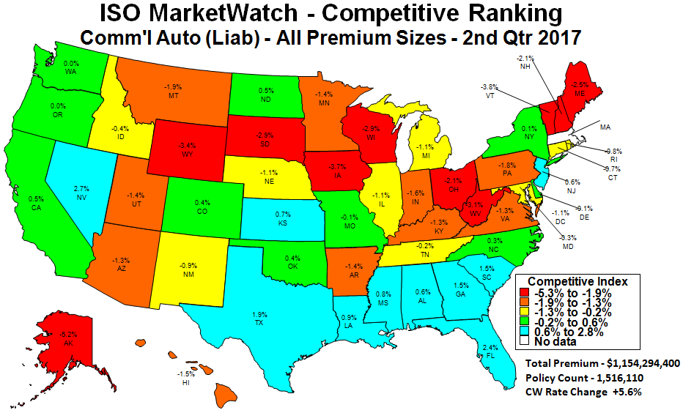
MarketWatch – Rate Change by State Graph in PPT

Slide 26
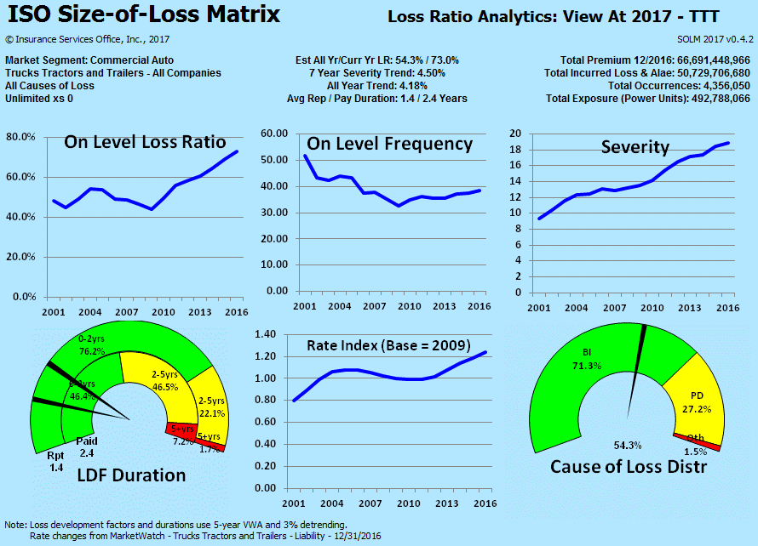
Size-of-Loss-Matrix – Example of Infographic (potential to be integrated with ML)
Holistic View of Troubles in Commercial Auto Market (2009 to 2017)
Illustrative

Slide 27
Portfolio Outcome Visualizer

Slide 28
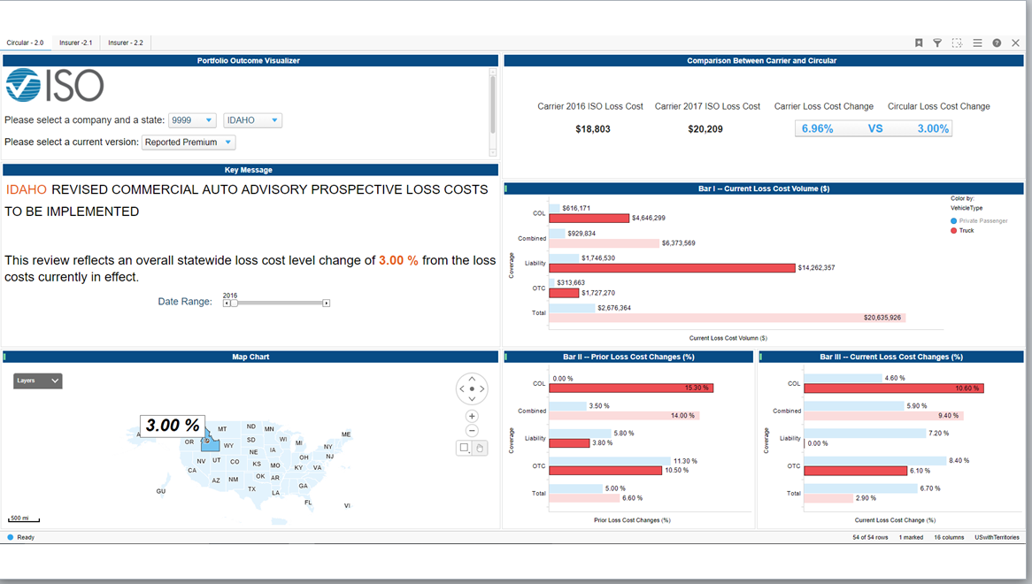
POV

Slide 29
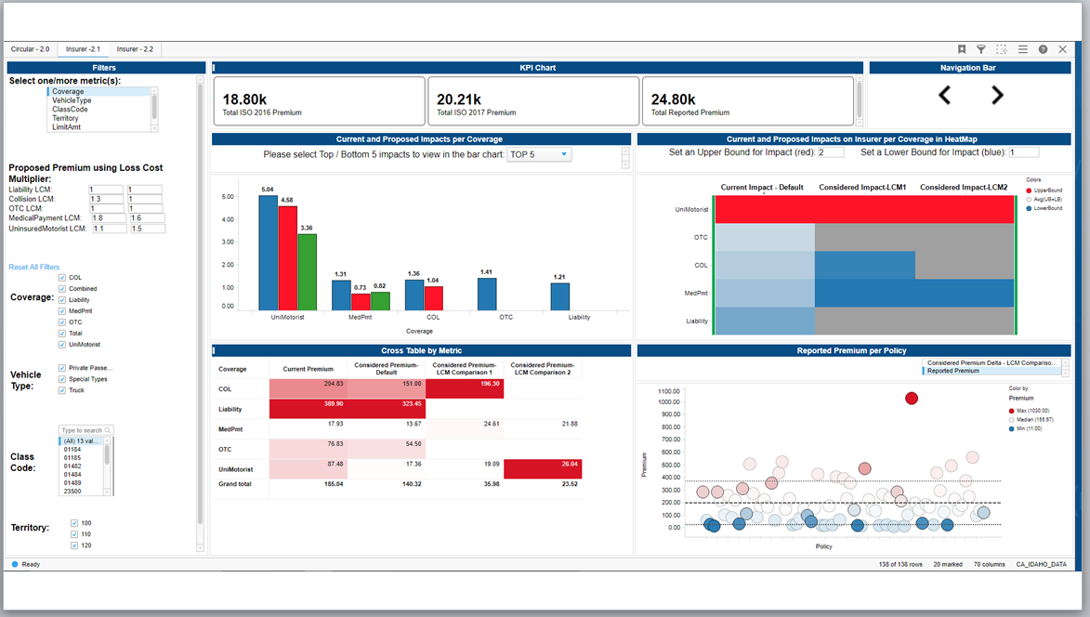
POV

Slide 30
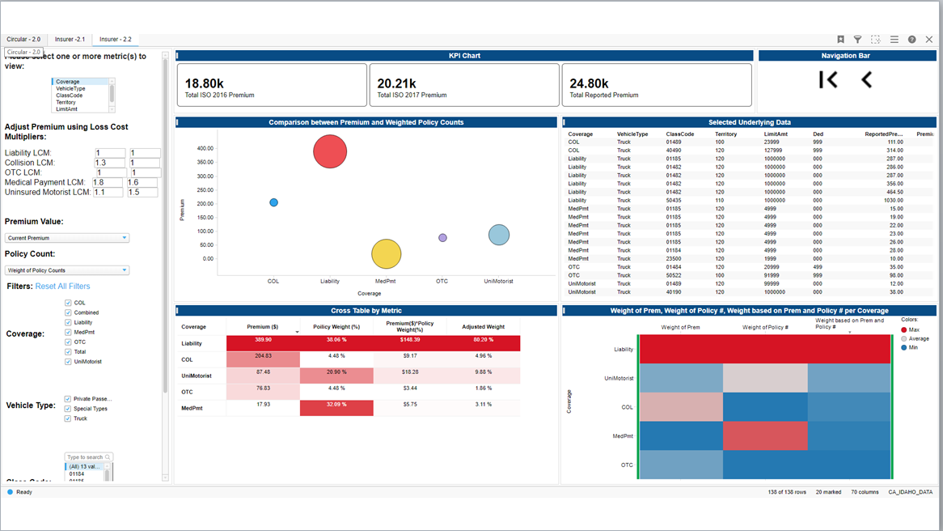
POV

